Slide 1


International Economics: Theory and Policy
Twelfth Edition
Chapter 19
International Monetary Systems: An Historical Overview
Copyright © 2022, 2018, 2015 Pearson Education, Inc. All Rights Reserved
Notes:
If this PowerPoint presentation contains mathematical equations, you may need to check that your computer has the following installed:
1) MathType Plugin
2) Math Player (free versions available)
3) NVDA Reader (free versions available)

Slide 2
Learning Objectives (1 of 3)
19.1 Explain how the goals of internal and external balance motivate economic policy makers in open economies.
19.2 Understand the monetary trilemma that policy makers in open economies inevitably face and how alternative international monetary systems address the trilemma in different ways.

Slide 3
Learning Objectives (2 of 3)
19.3 Describe the structure of the international gold standard
that linked countries’ exchange rates and policies prior
to World War
and the role of the Great Depression of
the 1930s in ending efforts to restore the pre-1914 world monetary order.
19.4 Discuss how the post–World War
Bretton Woods
system of globally fixed exchange rates was designed to combine exchange rate stability with limited autonomy of national macroeconomic policies.

Slide 4
Learning Objectives (3 of 3)
19.5 Explain how the Bretton Woods system collapsed in 1973 and why many economists at the time favored an international financial system such as the current one based on floating dollar exchange rates.
19.6 Summarize how the monetary and fiscal policies of a large country such as the United States are transmitted abroad under floating exchange rates.
19.7 Discuss how the world economy has performed in recent years and what lessons the post-1973 experience teaches about the need for international policy coordination.

Slide 5
Preview (1 of 2)
Goals of macroeconomic policies—internal and external balance
Gold standard era 1870–1914
International monetary system during interwar period 1918–1939
Bretton Woods system of fixed exchange rates 1944–1973

Slide 6
Preview (2 of 2)
Collapse of the Bretton Woods system
Arguments for floating exchange rates
Macroeconomic interdependence under a floating exchange rate
Foreign exchange markets since 1973

Slide 7
Macroeconomic Policy Goals (1 of 3)
Internal balance describes the macroeconomic goals of producing at potential output (at “full employment”) and of price stability (low inflation).
An unsustainable use of resources (overemployment) tends to increase prices; an ineffective use of resources (underemployment) tends to decrease prices.
Volatile aggregate demand and output tend to create volatile prices.
Price-level movements reduce economy’s efficiency by making the real value of the monetary unit less certain and thus a less useful guide for economic decisions.

Slide 8
Macroeconomic Policy Goals (2 of 3)
External balance is achieved when a current account is
neither so deeply in deficit that the country may be unable to repay its foreign debts,
nor so strongly in surplus that foreigners are put in that position.
For example, pressure on Japan in the 1980s and China in the 2000s.
An intertemporal budget constraint limits each country’s spending over time to levels that it can repay (with interest).

Slide 9
Macroeconomic Policy Goals (3 of 3)
When countries begin to have trouble meeting their payments on past foreign loans, foreign creditors become reluctant to lend them new funds and may even demand immediate repayment of the earlier loans.
Such an event is called a sudden stop in foreign lending.
In such cases, the home government may have to take severe action to reduce the country’s desired borrowing from foreigners to feasible levels as well as to repay maturing loans that foreigners are unwilling to renew.

Slide 10
Can A Country Borrow Forever? The Case of New Zealand
New Zealand has run current account deficits every year for as far back as official statistics have been recorded.
Lenders continue to extend credit and do not seem worried about whether they will be repaid.
Appears that a country can borrow year after year without going broke, as long as does not borrow too much.
By holding net exports to G D P constant at the right value, a country (like New Zealand) with initial net foreign debt will perpetually run deficits in its current account while still maintaining a constant ratio of net foreign liabilities to national output.

Slide 11
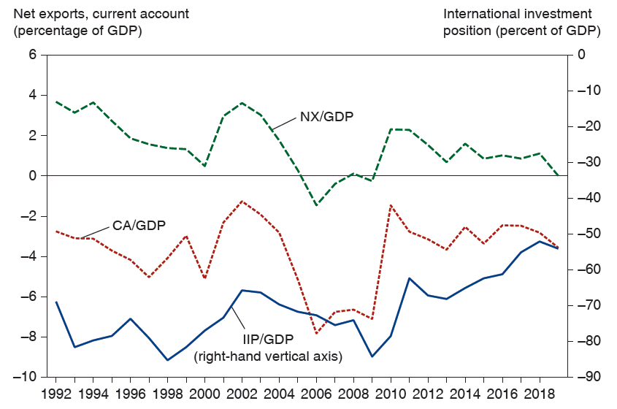
New Zealand’s Net Exports, Current Account, and Net International Investment Position, 1992–2019
New Zealand has consistently had a current account deficit for decades, yet its net foreign liabilities have averaged about 70 percent of G D P and have been falling in recent years.
Source: Statistics New Zealand.
Notes:
The graph depicts net exports, current account as a percentage of G D P, and international investment position as a percent of G D P, versus year. There are 3 plots, for New Zealand’s net exports, N X slash G D P, current account, C A slash G D P, and international investment position, I I P slash G D P. The plot for N X slash G D P falls from (19 92, 3.6) to (2000, 0.4), then rises to a peak at (2002, 3.8) before falling again to (2006, negative 1.8). The plot then rises to (2009, 2.2), then falls to (20 14, 1.3), and ends at (20 19, 0). The plot for C A slash G D P falls from (19 92, negative 2.2) to (19 96, negative 5), rises to a peak at (2002, negative 1), falls to (2006, negative 7.8), then rises to (20 10, negative 1.4) before falling again to (20 15, negative 2.5), and ends at (20 19, negative 3). The plot for I I P slash G D P falls from (19 92, negative 65) to (19 98, negative 85), then rises to (2002, negative 65) before falling again to (2009, negative 84). The plot then rises to (20 14, negative 65) and ends at (20 19, negative 55). All values estimated.

Slide 12
The Open-Economy Trilemma (1 of 2)
A country that fixes its currency’s exchange rate while allowing free international capital movements gives up control over domestic monetary policy.
A country that fixes its exchange rate can have control over domestic monetary policy if it restricts international
financial flows so that interest parity
need not hold.
Or a country can allow international capital to flow freely and have control over domestic monetary policy if it allows the exchange rate to float.

Slide 13
The Open-Economy Trilemma (2 of 2)
Impossible for a country to achieve more than two items from the following list:
Exchange rate stability.
Monetary policy oriented toward domestic goals.
Freedom of international capital movements.

Slide 14
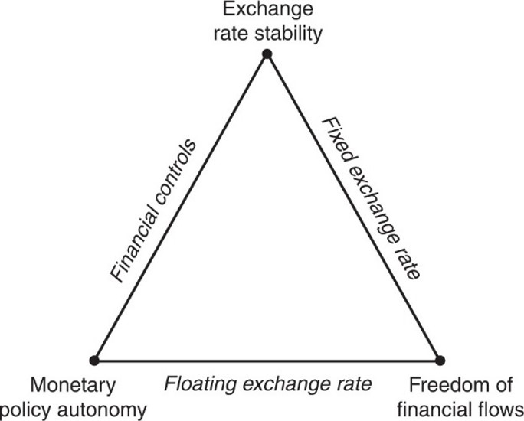
Figure 19.1 The Monetary Trilemma for Open Economies
The vertices of the triangle show three features that policy makers in open economies would prefer their monetary system to achieve. Unfortunately, at most two can coexist. Each of the three policy regime labels along the triangle’s edges (floating exchange rate, fixed exchange rate, financial controls) is consistent with the two goals that it lies between in the diagram.
Notes:
The edges and vertices are labeled clockwise from the top as follows: top vertex, exchange rate stability; right side, fixed exchange rate; lower right vertex, freedom of financial flows; base, floating exchange rate; lower left vertex, monetary policy autonomy; left side, financial controls.

Slide 15
Macroeconomic Policy under the Gold Standard 1870–1914
The gold standard from 1870 to 1914 and after 1918 had mechanisms that prevented flows of gold reserves (the balance of payments) from becoming too positive or too negative.
Prices tended to adjust according the amount of gold circulating in an economy, which had effects on the flows of goods and services: the current account.
Central banks influenced financial asset flows, so that the non-reserve part of the financial account matched the current account in order to reduce gold outflows or inflows.

Slide 16
Macroeconomic Policy under the Gold Standard (1 of 5)
Price-specie-flow mechanism is the adjustment of prices as gold (“specie”) flows into or out of a country, causing an adjustment in the flow of goods.
An inflow of gold tends to inflate prices.
An outflow of gold tends to deflate prices.
If a domestic country has a current account surplus in excess of the non-reserve financial account, gold earned from exports flows into the country—raising prices in that country and lowering prices in foreign countries.
Goods from the domestic country become expensive and goods from foreign countries become cheap, reducing the current account surplus of the domestic country and the deficits of the foreign countries.

Slide 17
Macroeconomic Policy under the Gold Standard (2 of 5)
Thus, price-specie-flow mechanism of the gold standard could automatically reduce current account surpluses and deficits, achieving a measure of external balance for all countries.

Slide 18
Macroeconomic Policy under the Gold Standard (3 of 5)
The Rules of the Game under the gold standard refer to another adjustment process that was theoretically carried out by central banks:
The selling of domestic assets to acquire money when gold exited the country as payments for imports. This decreased the money supply and increased interest rates, attracting financial inflows to match a current account deficit.
This reversed or reduced gold outflows.
The buying of domestic assets when gold enters the country as income from exports. This increased the money supply and decreased interest rates, reducing financial inflows to match the current account.
This reversed or reduced gold inflows.

Slide 19
Macroeconomic Policy under the Gold Standard (4 of 5)
Banks with decreasing gold reserves had a strong incentive to practice the rules of the game: they could not redeem currency without sufficient gold.
Banks with increasing gold reserves had a weak incentive to practice the rules of the game: gold did not earn interest, but domestic assets did.
In practice, central banks with increasing gold reserves seldom followed the rules.
And central banks often sterilized gold flows, trying to prevent any effect on money supplies and prices.

Slide 20
Macroeconomic Policy under the Gold Standard (5 of 5)
The gold standard’s record for internal balance was mixed.
The United States suffered from deflation, recessions, and financial instability during the 1870s, 1880s, and 1890s while trying to adhere to a gold standard.
The U.S. unemployment rate was 6.8% on average from 1890 to 1913, but it was less than 5.7% on average from 1946 to 1992.

Slide 21
Interwar Years: 1918–1939
The gold standard was stopped in 1914 due to war, but after 1918 it was attempted again.
The United States reinstated the gold standard from 1919 to 1933 at $20.67 per ounce and from 1934 to 1944 at $35.00 per ounce (a devaluation of the dollar).
The United Kingdom reinstated the gold standard from 1925 to 1931.
But countries that adhered to the gold standard for the longest time, without devaluing their currencies, suffered most from reduced output and employment during the 1930s.

Slide 22
Bretton Woods System: 1944–1973
In July 1944, 44 countries met in Bretton Woods, N H, to design the Bretton Woods system:
a fixed exchange rate against the U.S. dollar and a fixed dollar price of gold ($35 per ounce).
They also established other institutions:
The International Monetary Fund
The World Bank
General Agreement on Trade and Tariffs (G A T T), the predecessor to the World Trade Organization (W T O).

Slide 23
International Monetary Fund (1 of 2)
The I M F was constructed to lend to countries with persistent balance of payments deficits (or current account deficits), and to approve of devaluations.
Loans were made from a fund paid for by members in gold and currencies.
Each country had a quota, which determined its contribution to the fund and the maximum amount it could borrow.
Large loans were made conditional on the supervision of domestic policies by the I M F: I M F conditionality.
Devaluations could occur if the I M F determined that the economy was experiencing a “fundamental disequilibrium.”

Slide 24
International Monetary Fund (2 of 2)
Due to borrowing and occasional devaluations, the I M F was believed to give countries enough flexibility to attain an external balance, yet allow them to maintain an internal balance and stable exchange rates.
The volatility of exchange rates during 1918–1939, caused by devaluations and the vagaries of the gold standard, was viewed as a source of economic instability.

Slide 25
Bretton Woods System (1 of 2)
In order to avoid sudden changes in the financial account (possibly causing a balance of payments crisis), countries in the Bretton Woods system often prevented flows of financial assets across countries.
Yet they encouraged flows of goods and services because of the view that trade benefits all economies.
Currencies were gradually made convertible (exchangeable) between member countries to encourage trade in goods and services valued in different currencies.

Slide 26
Bretton Woods System (2 of 2)
Under a system of fixed exchange rates, all countries but the United States had ineffective monetary policies for internal balance.
The principal tool for internal balance was fiscal policy (government purchases or taxes).
The principal tools for external balance were borrowing from the I M F, restrictions on financial asset flows, and infrequent changes in exchange rates.

Slide 27
Policies for Internal and External Balance (1 of 4)
Suppose internal balance in the short run occurs when production is at potential output or when “full employment” equals aggregate demand:
An increase in government purchases (or a decrease in taxes) increases aggregate demand and output above its full employment level.
To restore internal balance in the short run, a revaluation (a fall in E) must occur.

Slide 28
Policies for Internal and External Balance (2 of 4)
Suppose external balance in the short run occurs when the current account achieves some value X:
An increase in government purchases (or a decrease in taxes) increases aggregate demand, output and income, decreasing the current account.
To restore external balance in the short run, a devaluation (a rise in E) must occur.

Slide 29
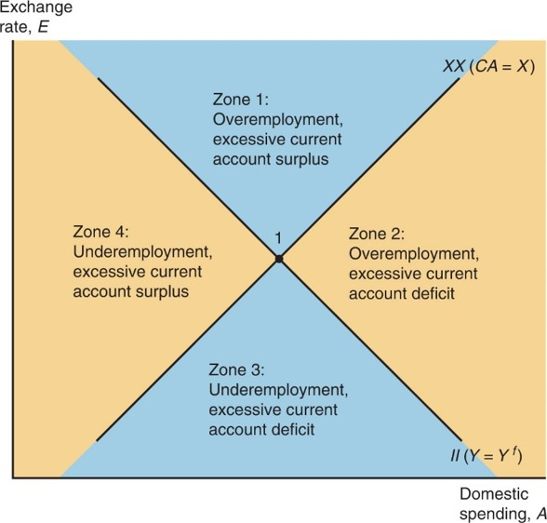
Figure 19.2 Internal Balance (I I), External Balance (X X), and the “Four Zones of Economic Discomfort”
The diagram shows what different levels of the exchange rate, E, and overall
domestic spending, A, imply for employment and the current account. Along I I,
output is at its full-employment level,
Along X X, the current account
is at its target level, X.
Notes:
A rising line, X X, C Ay = X, intersects a falling line, I I, Y = Y super f. This intersection is point 1 at the center of the graph. The intersection divides the graph into four equal areas, noted as zones 1 to 4. The following list provides information from the zones, clockwise from the top: zone 1, overemployment, excessive current account surplus; zone 2, overemployment, excessive current deficit; zone 3, underemployment, excessive current account deficit; zone 4, underemployment, excessive current account surplus.

Slide 30
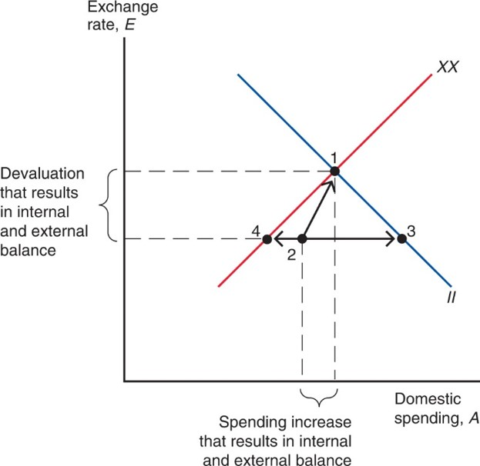
Figure 19.3 Policies to Bring about Internal and External Balance
Unless the currency is devalued and the level of domestic spending rises, internal and external balance (point 1) cannot be reached. Acting alone, a change in fiscal policy, for example, enables the economy to attain either internal balance (point 3) or external balance (point 4), but only at the cost of increasing the economy’s distance from the goal that is sacrificed.
Notes:
The line X X rises, as line I I falls, intersecting at point 1. Point 3 is on line I I, below and to the right of point 1. Point 4 is on line X X, below and to the left of point 1, at the same y-value as point 3. Point 2 also shares the same y-value, located between points 4 and 3, and closer to point 4. A rising arrow points from point 2 to point 1. The distance from point 2 to point 1 on the x-axis is the spending increase that results in internal and external balance. The distance on the y-axis from point 1 to points 4, 2, and 3 is the devaluation that results in internal and external balance.

Slide 31
Policies for Internal and External Balance (3 of 4)
But under the fixed exchange rates of the Bretton Woods system, devaluations were supposed to be infrequent, and fiscal policy was supposed to be the main policy tool to achieve both internal and external balance.
But in general, fiscal policy cannot attain both internal balance and external balance at the same time.
A devaluation, however, can attain both internal balance and external balance at the same time.

Slide 32
Policies for Internal and External Balance (4 of 4)
Under the Bretton Woods system, policy makers generally used fiscal policy to try to achieve internal balance for political reasons.
Thus, an inability to adjust exchange rates left countries facing external imbalances over time.
Infrequent devaluations or revaluations helped restore external and internal balance, but speculators also tried to anticipate them, which could cause greater internal or external imbalances.

Slide 33
U.S. External Balance Problems under Bretton Woods (1 of 3)
The collapse of the Bretton Woods system was caused primarily by imbalances of the United States during the 1960s and 1970s.
The U.S. current account surplus became a deficit in 1971.
Rapidly increasing government purchases increased aggregate demand and output, as well as prices.
Rising prices and a growing money supply caused the U.S. dollar to become overvalued in terms of gold and in terms of foreign currencies.

Slide 34
U.S. External Balance Problems under Bretton Woods (2 of 3)
Another problem was that as foreign economies grew, their need for official international reserves to maintain fixed exchange rates grew as well.
But this rate of growth was faster than the growth rate of the gold reserves that central banks held.
Supply of gold from new discoveries was growing slowly.
Holding dollar-denominated assets was the alternative.
At some point, dollar-denominated assets held by foreign central banks would be greater than the amount of gold held by the Federal Reserve.

Slide 35
U.S. External Balance Problems under Bretton Woods (3 of 3)
The Federal Reserve would eventually not have enough gold: foreigners would lose confidence in the ability of the Federal Reserve to maintain the fixed price of gold at $35/ounce, and therefore would rush to redeem their dollar assets before the gold ran out.
This problem is similar to what any central bank may face when it tries to maintain a fixed exchange rate.
If markets perceive that the central bank does not have enough official international reserve assets to maintain a fixed rate, a balance of payments crisis is inevitable.

Slide 36
Collapse of the Bretton Woods System (1 of 5)
The United States was not willing to reduce government purchases or increase taxes significantly, nor reduce money supply growth.
These policies would have reduced aggregate demand, output, and inflation and increased unemployment.
The United States could have attained some semblance of external balance at a cost of a slower economy.
A devaluation, however, could have avoided the costs of low output and high unemployment and still have attained external balance (an increased current account and official international reserves).

Slide 37
Collapse of the Bretton Woods System (2 of 5)
The imbalances of the United States , in turn, caused speculation about the value of the U.S. dollar, which caused imbalances for other countries and made the system of fixed exchange rates harder to maintain.
Financial markets had the perception that the U.S. economy was experiencing a “fundamental disequilibrium” and that a devaluation would be necessary.

Slide 38
Collapse of the Bretton Woods System (3 of 5)
First, speculation about a devaluation of the dollar caused investors to buy large quantities of gold.
The Federal Reserve sold large quantities of gold in March 1968, but closed markets afterwards.
Thereafter, individuals and private institutions were no longer allowed to redeem gold from the Federal Reserve or other central banks.
The Federal Reserve would sell only to other central banks at $35/ounce.
But even this arrangement did not hold: the United States devalued its dollar in terms of gold in December 1971 to $38/ounce.

Slide 39
Collapse of the Bretton Woods System (4 of 5)
Second, speculation about a devaluation of the dollar in terms of other currencies caused investors to buy large quantities of foreign currency assets.
A coordinated devaluation of the dollar against foreign currencies of about 8% occurred in December 1971.
Speculation about another devaluation occurred: European central banks sold huge quantities of European currencies in early February 1973, but closed markets afterward.
Central banks in Japan and Europe stopped selling their currencies and stopped purchasing of dollars in March 1973, and allowed demand and supply of currencies to push the value of the dollar downward.

Slide 40
Table 19.1 Inflation Rates in Industrial Countries, 1966–1972 (Percent Per Year)
Country | 1966 | 1967 | 1968 | 1969 | 1970 | 1971 | 1972
Britain | 3.6 | 2.6 | 4.6 | 5.2 | 6.5 | 9.7 | 6.9
France | 2.8 | 2.8 | 4.4 | 6.5 | 5.3 | 5.5 | 6.2
Germany | 3.4 | 1.4 | 2.9 | 1.9 | 3.4 | 5.3 | 5.5
Italy | 2.1 | 2.1 | 1.2 | 2.8 | 5.1 | 5.2 | 5.3
United States | 2.9 | 3.1 | 4.2 | 5.5 | 5.7 | 4.4 | 3.2
Source: Organization for Economic Cooperation and Development. Main Economic Indicators: Historical Statistics, 1964–1983. Paris: O E C D, 1984. Figures are percentage increases in each year’s average consumer price index over that of the previous year.

Slide 41
Collapse of the Bretton Woods System (5 of 5)
The Bretton Woods system collapsed in 1973 because central banks were unwilling to continue to buy overvalued dollar-denominated assets and to sell undervalued foreign currency–denominated assets.
In 1973, central banks thought they would temporarily stop trading in the foreign exchange market and would let exchange rates adjust to supply and demand, and then would reimpose fixed exchange rates soon.
But no new global system of fixed rates was started again.

Slide 42
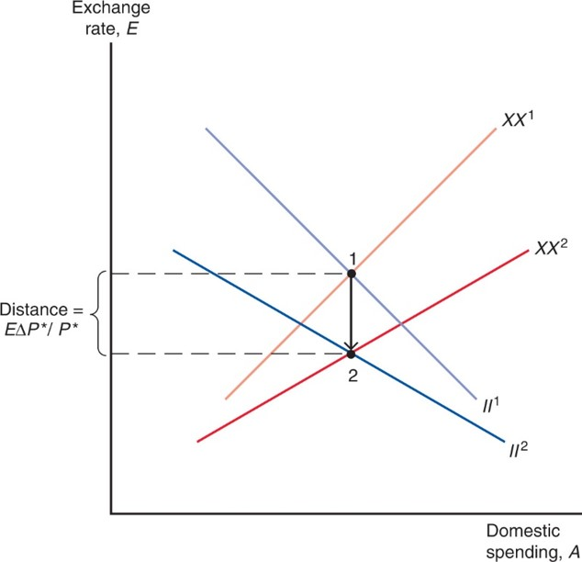
Figure 19.4 Effect on Internal and External Balance of a Rise in the Foreign Price Level, P*
After P* rises, point 1 is in zone 1 (overemployment and an excessive surplus). Revaluation (a fall in E) restores balance immediately by moving the policy setting to point 2.
Notes:
X X super 2 is plotted below X X super 1, and has a lesser slope. I I super 2 is plotted below I I super 1, and also has a lesser slope. X X super 2 intersects I I super 2 and point 2, below point 1 at the same x-value. The vertical distance between point 1 and point 2 = the exchange rate times the change in the foreign price level, over the foreign price level.

Slide 43
Case for Floating Exchange Rates (1 of 6)
Monetary policy autonomy
Without a need to trade currency in foreign exchange markets, central banks are more free to influence the domestic money supply, interest rates, and inflation.
Central banks can more freely react to changes in aggregate demand, output, and prices in order to achieve internal balance.

Slide 44
Case for Floating Exchange Rates (2 of 6)
Automatic stabilization
Flexible exchange rates change the prices of a country’s products and help reduce “fundamental disequilibria.”
One fundamental disequilibrium is caused by an excessive increase in money supply and government purchases, leading to inflation, as we saw in the United States during 1965–1972.
Inflation causes the currency’s purchasing power to fall, both domestically and internationally, and flexible exchange rates can automatically adjust to account for this fall in value, as purchasing power parity predicts.

Slide 45
Case for Floating Exchange Rates (3 of 6)
Another fundamental disequilibrium could be caused by a change in aggregate demand for a country’s products.
Flexible exchange rates would automatically adjust to stabilize high or low aggregate demand and output, thereby keeping output closer to its normal level and also stabilizing price changes in the long run.

Slide 46
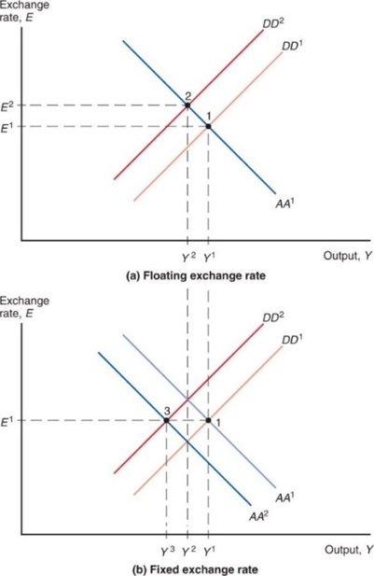
Figure 19.5 Effects of a Fall in Export Demand
The response to a fall in export demand (seen in the shift from
differs under
floating and fixed exchange rates. (a) With a floating rate, output falls only to
as the
currency’s depreciation
shifts demand back toward domestic goods. (b)
With the exchange rate fixed at
output falls all the way to
as the
central bank reduces the money supply (reflected in the shift from
Notes:
Graph ay is the floating exchange rate, and has two rising parallel lines, D D super 1 and, above and to the left, D D super 2. The falling line Ay Ay super 1 intersects D D super 1 at point 1 and D D super 2 at point 2. Point 1 is below and to the right of point 2; point 1 is located at (Y super 1, E super 1); point 2 is at (Y super 2, E super 2). Graph b is the fixed exchange rate, and adds a second falling line Ay Ay super 2 to a duplicate of graph ay. Ay Ay super 2 is to the left of and parallel to Ay Ay super 1. The intersection of D D super 2 and Ay Ay super 2 is point 3 at (Y super 3, E super 1) with Y super 3 left of Y super 2 on the x-axis.

Slide 47
Case for Floating Exchange Rates (4 of 6)
In the long run, a real depreciation of domestic products occurs as prices fall (due to low aggregate demand, output, and employment) under fixed exchange rates.
In the short run and long run, a real depreciation of domestic products occurs through a nominal depreciation under flexible exchange rates.
Fixed exchange rates cannot survive for long in a world with divergent macroeconomic policies and other changes that affect national aggregate demand and national income differently.

Slide 48
Case for Floating Exchange Rates (5 of 6)
Flexible exchange rates may also prevent speculation in some cases.
Fixed exchange rates are unsustainable if markets believe that the central bank does not have enough official international reserves.

Slide 49
Case for Floating Exchange Rates (6 of 6)
Symmetry (not possible under Bretton Woods)
The United States is now allowed to adjust its exchange rate, like other countries.
Other countries are allowed to adjust their money supplies for macroeconomic goals, like the United States could.

Slide 50
Since 1973 (1 of 6)
In 1975, I M F members met in Rambouillet, France to allow flexible exchange rates, but to prevent “erratic fluctuations.”
In 1976 in Kingston, Jamaica, they amended the articles of agreement for I M F membership to formally endorse flexible rates,
but prevented members from “manipulating exchange rates … to gain an unfair competitive advantage”: no expenditure-switching policies were allowed.
The articles allowed “surveillance” of members by other members to be sure they were acting fairly.

Slide 51
Since 1973 (2 of 6)
Due to contractionary monetary policy and expansive fiscal policy in the United States , the dollar appreciated by about 50% relative to 15 currencies from 1980 to 1985.
This contributed to a growing current account deficit by making imports cheaper and U.S. goods more expensive.

Slide 52
Table 19.2 Macroeconomic Data for Key Industrial Regions, 1963–2019 (1 of 2)
Inflation (percent per year)
Period | 1963–1972 | 1973–1982 | 1983–1992 | 1993–2006 | 2007–2009 | 2010–2015 | 2016–2019
United States | 3.3 | 8.8 | 3.8 | 2.6 | 2.1 | 1.7 | 1.9
Europe | 3.9 | 10.1 | 5.8 | 3.1 | 2.5 | 1.5 | 1.2
Japan | 5.5 | 8.7 | 1.8 | 0.1 | 0.0 | 0.5 | 0.5
Unemployment (percent of labor force)
Period | 1963–1972 | 1973–1982 | 1983–1992 | 1993–2006 | 2007–2009 | 2010–2015 | 2016–2019
United States | 4.7 | 7.0 | 6.8 | 5.3 | 6.6 | 7.6 | 4.2
Europe | 1.9 | 5.5 | 9.4 | 10.2 | 7.9 | 10.4 | 7.8
Japan | 1.2 | 1.9 | 2.5 | 4.1 | 4.3 | 4.2 | 2.6

Slide 53
Table 19.2 Macroeconomic Data for Key Industrial Regions, 1963–2019 (2 of 2)
Per Capita Real GDP Growth (percent per year)
Period | 1963–1972 | 1973–1982 | 1983–1992 | 1993–2006 | 2007–2009 | 2010–2015 | 2016–2019
United States | 4.0 | 2.3 | 3.5 | 3.2 | negative 0.3 | 2.2 | 2.2
Europe | Blank | 2.6 | 2.5 | 2.2 | negative 0.3 | 1.2 | 2.3
Japan | 7.9 | 3.7 | 4.0 | 1.1 | negative 1.7 | 1.5 | 1.1
Source: International Monetary Fund, Eurostat, and World Bank.

Slide 54
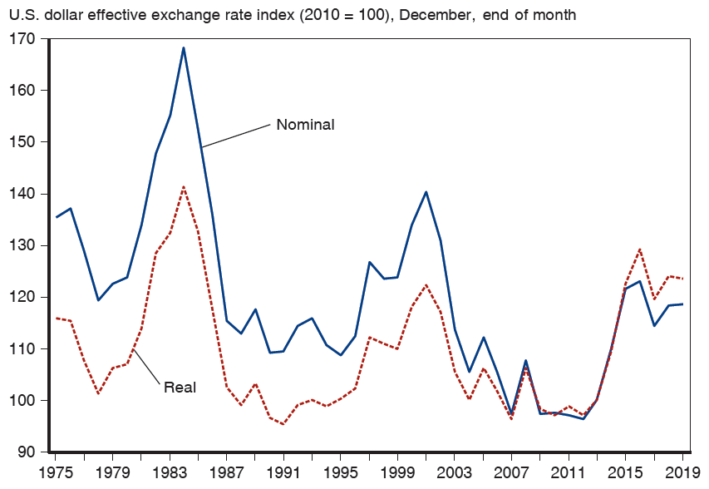
Figure 19.6 Nominal and Real Effective Dollar Exchange Rate Indexes, 1975–2019
The indexes are measures of the nominal and real value of the U.S. dollar in terms of a basket of foreign currencies. An increase in the indexes is a dollar appreciation; a decrease, a dollar depreciation. For both indexes, the 2005 value is 100.
Source: Bank for International Settlements.
Notes:
The graph plots the U S dollar effective exchange rate index, 20 10 = 100, December, end of month, versus year, 19 75 to 20 19. The real index is below the nominal index until 2007 and they track closely together with two peaks in 19 84 and 2001. The plot for real index rises from (19 75, 115) to (19 84, 142), then falls to (19 91, 97), rises again to (2001, 126), and then falls to (2007, 96). The plot then rises to (20 16, 130) and ends at (20 19, 125). The plot for normal index rises from (19 75, 138) to (19 85, 168), then falls to (19 95, 112). The plot then rises to (2001, 140), falls to (20 12, 98), then rises to (20 16, 132) and ends at (20 19, 120). All values estimated.

Slide 55
Since 1973 (3 of 6)
To reduce the value of the U S $, the United States, Germany, Japan, Britain, and France announced in 1985 that their central banks would jointly intervene in the foreign exchange markets in order to reduce the value of the dollar.
The dollar dropped sharply the next day and continued to drop as the United States continued a more expansionary monetary policy, pushing down interest rates.
The agreement was called the Plaza Accords, because it was announced at the Plaza Hotel in New York.

Slide 56
Since 1973 (4 of 6)
After the value of the dollar fell, countries were interested in stabilizing exchange rates.
United States, Germany, Japan, Britain, France, and Canada announced renewed cooperation in 1987, pledging to stabilize exchange rates.
They calculated zones of about
around which
current exchange rates were allowed to fluctuate.
The agreement was called the Louvre Accords, because it was announced at the Louvre in Paris.

Slide 57
Since 1973 (5 of 6)
It is not at all apparent that the Louvre Accords succeeded in stabilizing exchange rates.
The stock market crash in October 1987 made production, employment, and price stability the primary goals for the U.S. central bank, and exchange rate stability became less important.
New targets were (secretly) made after October 1987, but central banks had abandoned these targets by the early 1990s.

Slide 58
Since 1973 (6 of 6)
Many fixed exchange rate systems have nonetheless developed since 1973.
European monetary system and euro zone (studied in Econ Chapter 21/Finance Chapter 10).
The Chinese central bank currently fixes the value of its currency.
A S E A N countries have considered a fixed exchange rates and policy coordination.
No system is right for all countries at all times.

Slide 59
Macroeconomic Interdependence under Floating Exchange Rates (1 of 5)
Previously, we assumed that countries are “small” in that their policies do not affect world markets.
For example, a depreciation of the domestic currency was assumed to have no significant influence on aggregate demand, output, and prices in foreign countries.
For countries like Costa Rica, this may be an accurate description.
However, large economies such as the United States, E U, Japan, and China are interdependent because policies in one country affect other economies.

Slide 60
Macroeconomic Interdependence under Floating Exchange Rates (2 of 5)
If the United States permanently increases the money supply, the D D-A A model predicts for the short run:
an increase in U.S. output and income
a depreciation of the U.S. dollar
What would be the effects for Japan?
an increase in U.S. output and income would raise demand for Japanese products, thereby increasing aggregate demand and output in Japan.
a depreciation of the U.S. dollar means an appreciation of the yen, lowering demand for Japanese products, thereby decreasing aggregate demand and output in Japan.
The total effect of (1) and (2) is ambiguous.

Slide 61
Macroeconomic Interdependence under Floating Exchange Rates (3 of 5)
If the United States permanently increases government purchases, the D D-A A model predicts:
an appreciation of the U.S. dollar.
What would be the effects for Japan?
an appreciation of the U.S. dollar means an depreciation of the yen, raising demand for Japanese products, thereby increasing aggregate demand and output in Japan.
What would be the subsequent effects for the United States ?
Higher Japanese output and income means that more income is spent on U.S. products, increasing aggregate demand and output in the United States in the short run.

Slide 62
Macroeconomic Interdependence under Floating Exchange Rates (4 of 5)
In fact, the United States has depended on saved funds from many countries, while it has borrowed heavily.
The United States has run a current account deficit for many years due to its low saving and high investment expenditure.

Slide 63
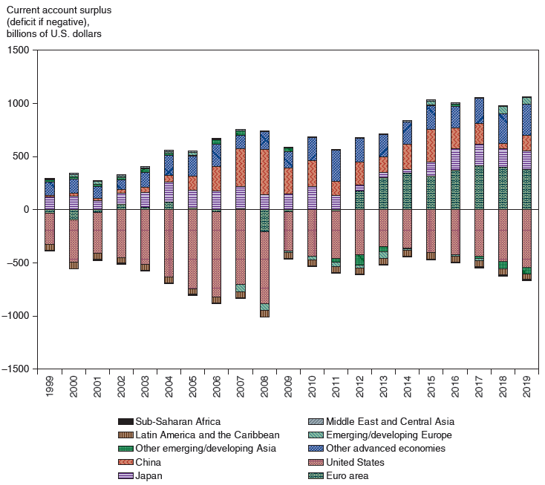
Figure 19.7 Global External Imbalances, 1999–2019
During the first half of the 2000s, the large increase in the U.S. current account deficit was matched by increases in the surpluses of Asian countries (notably China), Latin America, and oil exporters. After 2008 the imbalances shrank temporarily, but have since increased, with the euro area developing a big surplus.
Source: International Monetary Fund, World Economic Outlook database, October 2019. Numbers for 2019 are projections.
Notes:
A stacked bar graph depicts current account surplus and deficit in billions of U S dollars versus year for 10 countries or regions. The 10 countries or regions are as follows. Sub Saharan Africa, Latin America and the Caribbean, Other emerging slash developing Asia, China, Japan, Middle East and Central Asia, Emerging slash developing Europe, Other advanced economies, United States, Euro area. The vertical axis ranges from negative 1500 to 1500 in increments of 500. From 19 99 to 2006, the U S deficit grew from negative 250 in 19 99 through negative 800 in 2006. It then declined through negative 1000 in 2008 to negative 320 in 20 14, and grew to negative 600 in 20 19. Most other identified nations or regions, including China, newly industrial Asia, Middle East and North Africa, and the Euro area, increased in surplus from a combined 280 in 19 99 to 750 in 2008, then decreased to 600 in 2009 before increasing again to 1000 in 20 19. All values estimated.

Slide 64
Macroeconomic Interdependence under Floating Exchange Rates (5 of 5)
But as foreign countries spend more and lend less to the United States,
interest rates are rising slightly
the U.S. dollar is depreciating
the U.S. current account is increasing (becoming less negative).

Slide 65
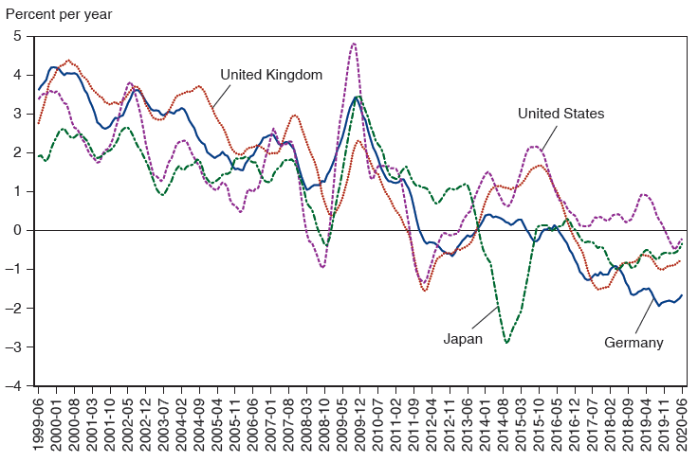
Figure 19.8: Long-Term Real Interest Rates for the United States, Germany, Japan, and the United Kingdom, 1999–2020
Real interest rates fell to low levels in the 2000s. Many countries followed the same trend.
Source: O E C D. Real interest rates are six-month moving averages of monthly nominal interest rates on 10-year government bonds less inflation over the preceding year.
Notes:
The graph plots real interest rates in percent per year versus year from June 19 99 to June 20 20. There are 4 plots for the United States, United Kingdom, Germany, and Japan. The 4 plots fall from a range of 1.8 to 4 in 19 99 to a range of 0 to negative 2 in 20 20. The plots for the United States and Japan fall below 0 to negative 0.7 between 2007 and 2008, before rising above 0 in 2009. The plots for the United States, United Kingdom, Germany, and Japan fall below 0 to negative 3 between 20 11 and 20 20, on a number of occasions. All values estimated.

Slide 66
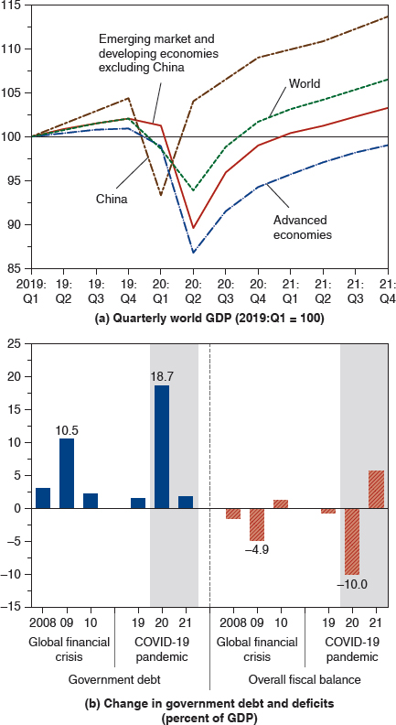
Figure 19.9 Immediate Output and Fiscal Consequences of the Global Pandemic Crisis
Global output levels declined sharply because of the pandemic lockdown, while governments responded with fiscal measures even more aggressive than during earlier global financial crisis. Panel (a) shows indices of the level of G D P. Panel (b) shows aggregate global pubic debt and deficits.
Source: International Monetary Fund, World Economic Outlook, June 2020 update, based on I M F staff estimates.
Notes:
The graphs are as follows. A line graph titled, quarterly world G D P, 20 19 Q 1 = 100, plots G D P output versus period from 20 19 Q 1. The horizontal axis plots the period from Q 1 of 20 19 to Q 4 in 20 21. The vertical axis ranges from 85 to 115 in increments of 5. The data plotted are as follows. The line graph for emerging market and developing economies except China, starts at (20 19 Q 1, 100), rises to (20 20 Q 1, 101), declines sharply to (20 20 Q 2, 90), and then rises through (20 21 Q 1, 100) and (20 21 Q 4, 102.5). The line graph for China starts at (20 19 Q 1, 100), rises to (20 19 Q 4, 105), falls sharply to (20 20 Q 1, 92.5), and then rises through (20 20 Q 2, 100), (20 20 Q 4, 107.5), and (20 21 Q 4, 112.5). The line graph for advanced economies starts at (20 19 Q 1, 100), rises to (20 19 Q 4, 101), falls sharply to (20 20 Q 2, 87.3), and then rises through (20 20 Q 4, 94.5), and (20 21 Q 4, 98.5). The line graph for the world starts at (20 19 Q 1, 100), rises to (20 19 Q 4, 102), falls to (20 20 Q 2, 95), and then rises through (20 20 Q 4, 99), and (20 21 Q 4, 105). All values are estimated. A bar graph titled, change in government debt and deficits, in percent of G D P. The graph has two sections, government debt and overall fiscal balance, where the period of global financial crisis of 2008 and COVID 19 pandemic are plotted. The vertical axis ranges from negative 15 to 25 in increments of 5. The bins plotted are as follows. Government debt. Global financial crisis. 2008, 2.5. 2009, 10.5. 20 10, 2. COVID 19 pandemic. 20 19, 1.5. 20 20, 18.7. 20 21, 1.9. Overall fiscal balance. Global financial crisis. 2008, negative 2.1. 2009, negative 4.9. 20 10, 1.2. COVID 19 pandemic. 20 19, negative 0.8. 20 20, negative 10.0. 20 21, 5.8. All values are estimated.

Slide 67
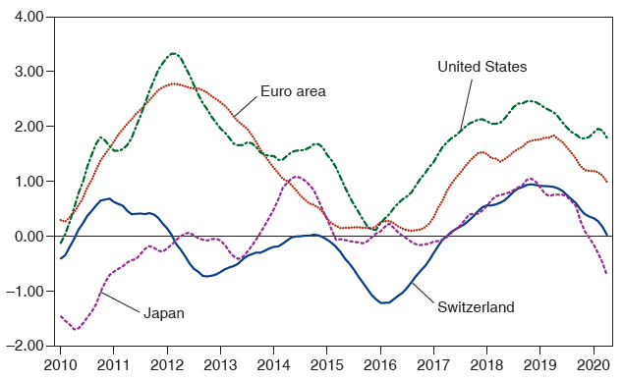
Recent Inflation Rates in Some Advanced Countries
The numbers shown are 12-month moving averages of monthly year-over-year inflation rates. Japan’s C P I has been adjusted for the April 2014 and October 2019 increases in its consumption tax rates.
Sources: O E C D and Statistics Bureau of Japan.
Notes:
The graph depicts inflation in percent per year versus year, with 4 plots, for the United States, Euro area, Switzerland, and Japan. The plot for the United States rises from (20 10, negative 0.1) to (20 12, 3.4), then falls to 0.2 near the end of 20 16, rises to 2.0 during 20 19 and ends at (20 20, 2.00). The plot for Euro area rises from (20 10, 0.3) to (20 12, 2.6), then falls to 0.1 near the end of 20 16, rises to 1.6 in 20 18 and then falls to (20 20, 1.2). The plot for Switzerland rises from (20 10, negative 0.2) to (20 11, 0.7), then falls to negative 0.8 in the second half of 20 12. The plot then rises to 0 near the end of 20 14, falls to negative 1.3 in 20 16, then rises again to 1.00 during 20 19 and ends at (20 20, 0). The plot for Japan rises from (20 10, negative 1.5) through 0 in mid 20 12, falls to negative 0.4 in the first half of 20 13, then rises to a peak at 1 in the first half of 20 19. The plot then falls to 0 during 20 20. All values estimated.

Slide 68
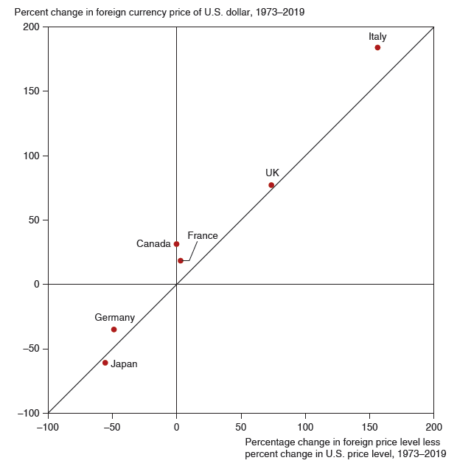
Figure 19.10 Exchange Rate Trends and Inflation Differentials, 1973–2019
Over the floating-rate period as a whole, higher inflation has been associated with greater currency depreciation. The exact relationship predicted by relative P P P, however, has not held for most countries. The inflation difference on the horizontal axis is calculated as
using the exact relative P P P
relation given in footnote 1 of Chapter 16.
Source: International Monetary Fund, International Financial Statistics and Global Financial Data.
Notes:
The scatter diagram plots percent changes in foreign currency price of the U S dollar, 19 73 to 20 19, versus percentage change in the foreign price level less percent change in the U S price level for 19 73 to 20 19. A line of best fit rises at a 45 degree angle through the following points. Japan, (negative 50, negative 60). Germany, (negative 51, negative 35). Canada, (0, 35). France, (1, 25). U K (90, 75). Italy, (165, 185). All values estimated.

Slide 69
Summary (1 of 5)
Internal balance means that an economy enjoys normal output and employment and price stability.
External balance roughly means a stable level of official international reserves or a current account that is not too positive or too negative.
The gold standard had two mechanisms that helped to prevent external imbalances:
Price-specie-flow mechanism: the automatic adjustment of prices as gold flows into or out of a country.
Rules of the game: buying or selling of domestic assets by central banks to influence flows of financial assets.

Slide 70
Summary (2 of 5)
The Bretton Woods agreement in 1944 established fixed exchange rates, using the U.S. dollar as the reserve currency.
The I M F was also established to provide countries with financing for balance of payments deficits and to judge if changes in fixed rates were necessary.
Under the Bretton Woods system, fiscal policies were used to achieve internal and external balance, but they could not do both simultaneously, so external imbalances often resulted.

Slide 71
Summary (3 of 5)
Internal and external imbalances of the United States —caused by rapid growth in government purchases and the money supply—and speculation about the value of the U.S. dollar in terms of gold and other currencies ultimately broke the Bretton Woods system.
High inflation from U.S. macroeconomic policies was transferred to other countries late in the Bretton Woods system.

Slide 72
Summary (4 of 5)
Arguments for flexible exchange rates are that they allow monetary policy autonomy, can stabilize the economy as aggregate demand and output change, and can limit some forms of speculation.
Arguments against flexible exchange rates are that they allow expenditure switching policies, can make aggregate demand and output more volatile because of uncoordinated policies across countries, and make exchange rates more volatile.

Slide 73
Summary (5 of 5)
Since 1973, countries have engaged in two major global efforts to influence exchange rates:
The Plaza Accords reduced the value of the dollar relative to other major currencies.
The Louvre Accords agreement was intended to stabilize exchange rates, but it was quickly abandoned.
Models of large countries account for the influence that domestic macroeconomic policies have in foreign countries.

Slide 74
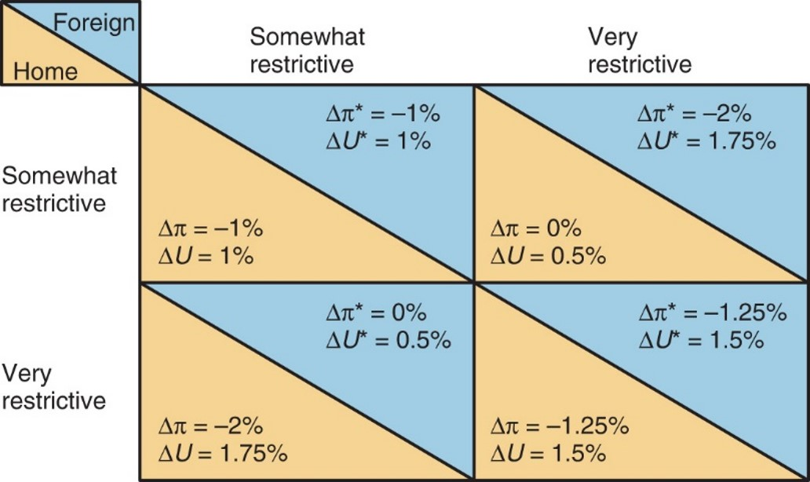
Figure 19A.1 Hypothetical Effects of Different Monetary Policy Combinations on Inflation and Unemployment
Monetary policy choices in one country affect the outcomes of monetary policy choices made abroad.
Notes:
The following list provides data from the matrix. Home and foreign both somewhat restrictive: results are the same for both, inflation drops 1% and unemployment rises 1%. Home somewhat restrictive and foreign very restrictive: home inflation is unchanged and unemployment rises 0.5%, foreign inflation drops 2% and inflation rises 1.75%. Home very restrictive and foreign somewhat restrictive: home inflation drops 2% and unemployment rises 1.75%, foreign inflation is unchanged and unemployment rises 0.5%. Both home and foreign very restrictive: both entities have the same result of inflation dropping 1.25% and unemployment rising 1.5%.

Slide 75
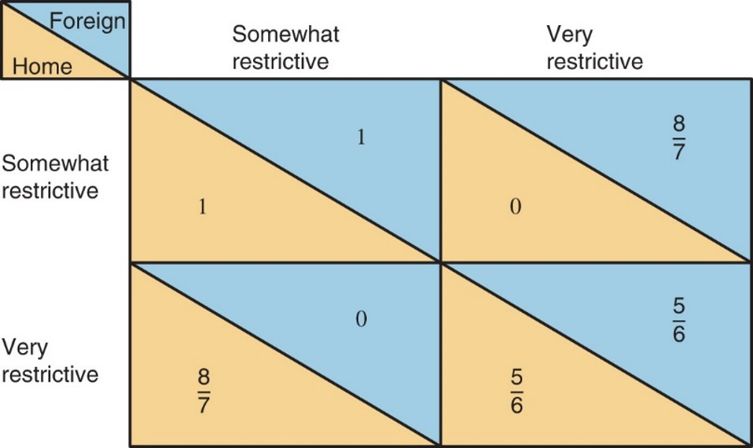
Figure 19A.2 Payoff Matrix for Different Monetary Policy Moves
Each entry equals the reduction in inflation per unit rise in the unemployment rate
If each country “goes it alone,” they both choose very
restrictive policies. Somewhat restrictive policies, if adopted by both countries, lead to an outcome better for both.
Notes:
The following list provides data from the matrix. Home and foreign both somewhat restrictive: results are the same for both, 1. Home somewhat restrictive and foreign very restrictive: home 0, foreign 8 sevenths. Home very restrictive and foreign somewhat restrictive: home 8 sevenths, foreign 0. Both home and foreign very restrictive: both entities have the same result of 5 sixths.

Slide 76

Copyright
This work is protected by United States copyright laws and is provided solely for the use of instructors in teaching their courses and assessing student learning. Dissemination or sale of any part of this work (including on the World Wide Web) will destroy the integrity of the work and is not permitted. The work and materials from it should never be made available to students except by instructors using the accompanying text in their classes. All recipients of this work are expected to abide by these restrictions and to honor the intended pedagogical purposes and the needs of other instructors who rely on these materials.

